Slide 1
THE AURORA BOREALIS

Slide 2
What is the Aurora Borealis?
The Aurora is an incredible light show caused by collisions between electrically charged particles released from the sun that enter the earth’s atmosphere and collide with gases such as oxygen and nitrogen. The lights are seen around the magnetic poles of the northern and southern hemispheres.
Auroras that occur in the northern hemisphere are called ‘Aurora Borealis’ or ‘northern lights’ and Auroras that occur in the southern hemisphere are called ‘Aurora Australis’ or ‘southern lights’.
Auroral displays can appear in many vivid colours, although green is the most common. Colours such as red, yellow, green, blue and violet are also seen occasionally. The auroras can appear in many forms that light up the sky with an incredible glow.
Variations in colour are due to the type of gas particles that are colliding. The most common aurora colour which is green, is produced by oxygen molecules located about 60 miles above the earth. The rarer red auroras are produced by high-altitude oxygen, at heights of up to 200 miles. Nitrogen produces blue or purple aurora.

Slide 3
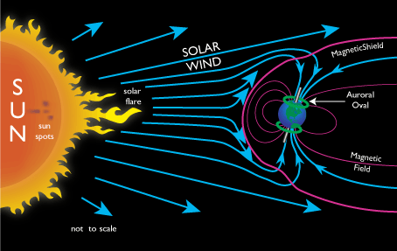
How do charged particles from the sun get here?
Generally, it is when there is an opening in the sun’s atmosphere that allows electrons and protons to flow out. But we need a lot of charged particles colliding with earth’s atmosphere to create Auroras, so this usually requires a large opening, such as a coronal hole, or a sunspot. Thanks to research conducted since the 1950′s, we now know that electrons and protons from the sun are blown towards the earth on the ‘solar wind’.
When the charged particles are blown towards the earth by the solar wind, they are largely deflected by the earth’s magnetic field. However, the earth’s magnetic field is weaker at either pole and therefore some particles enter earth’s atmosphere and collide with gas particles. These collisions emit light that we perceive as the dancing lights of Auroras.
The lights of the Aurora generally extend from 80 kilometres (50 miles) to as high as 640 kilometres (400 miles) above the earth’s surface.

Slide 4
Where is the best place to whatch Aurora?
The northern hemisphere is the most sensible option of viewing Aurora. However during strong solar storms, Aurora Australis are often visible in places south from Australia. But generally, the best places to watch the Aurora are usually North America or Europe.
In North America, the north western parts of Canada, particularly the Yukon, Nunavut, Northwest Territories and Alaska are favourable. In Europe, Scandinavia, particularly the Lapland areas of Norway, Sweden and Finland is very good for Aurora viewing. Iceland is also a good place for Auroras and Auroral displays can also be seen over the southern tip of Greenland.
The ‘light pollution’ will ruin any Aurora show, so the best places to watch the Auroras should be away from light pollution.
If there are clouds, forget all the above! Auroras are not visible through most types clouds.

Slide 5
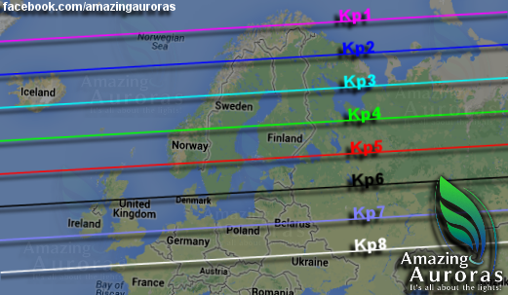
The following graphic shows what strength Kp is needed to view Aurora where you are, because if you move away from the north pole, the Aurora will be more towards the horizon.

Slide 6
Northern Lights Legends from Around the World
Ancient Greece and the Romans
Aurora Borealis is derived from the Greek words “Aurora” meaning “sunrise” and “Boreas” meaning “wind”. For the ancient Greeks to have seen the lights there must have been some incredibly strong solar activity because sightings so far south are almost unheard of. The Greeks held that Aurora was the sister of Helios and Seline, the sun and moon respectively, and that she raced across the early morning sky in her multi-coloured chariot to alert her siblings to the dawning of a new day.
The Romans also associated the Northern Lights with a new day believing them to be Aurora, the goddess of dawn.

Slide 7
China and Japan
It is said that many of the early Chinese legends associated with dragons were a result of the Northern Lights. The belief is that the lights were viewed as a celestial battle between good and evil dragons who breathed fire across the firmament.
In Japanese culture, the belief is that a child conceived underneath the Northern Lights will be blessed with good looks, intellect and good fortune. Indeed, there is a fascination with the Aurora in South East Asia and it is no coincidence that visitor numbers from the likes of Japan, Singapore and Malaysia have increased significantly in recent times.

Slide 8
Northern Scandinavia and Iceland
In Greenland and Iceland the lights were linked to giving birth.
One of our absolute favourite myths comes from Finland where it was held that the lights were caused by the firefox who ran so quickly across the snow that his tail caused sparks to fly into the night sky creating the Aurora. Indeed, the Finnish word for the Northern Lights “revontulet” translates literally as “fire fox”.
In Sweden, the Aurora was often seen as a portent of good news. Many of our Swedish forefathers believed the lights to be a gift from benevolent gods providing warmth and light in the form of a volcano in the north. Elsewhere in the country they were believed to be the light reflection from large shoals of herring and bode well for the local fishermen and the Swedish farming community saw the lights as heralding a good harvest in the coming year.

Slide 9
Thanks for your attention
Made by: Lorella Lo Giudice
Tutor: Valeria Pipitone
Bibliography:
http://www.aurora-service.eu/aurora-school/aurora-borealis/
https://www.theaurorazone.com/about-the-aurora/aurora-legends/

